Slide 1
C300 Final Evaluation
Project ID:
SOI-2021-2120-0019
Project Title:
[IP] Automated Car-Plate Recognition System (ACRS)
Team ID:
SOI-2021-008
Team Members:
Soong Jia Kang Daniel
Muhamad Izharfan Bin Zuraimi
Nurul Natasha Bte Rizal
Elly Haniz Bte Mohamed Ghazali

Slide 2
Project Details
The key objective of the project is to support SGSecure. In the event of a school lock-down, vehicle access to Republic Polytechnic (RP) will be restricted to RP staff registered vehicles. There will only be a single-point-of-entry into RP and Office of Estate (OES) will need to verify the existence of the vehicle record before it can enter RP. There are over 500 RP registered vehicles and currently manual checks are the only option. We are recommending an Automated Recognition System (ARS) that is equipped with a license plate recognition capability to.
The process of the ARS will be as follows:
I. Identify the license plate from an image taken via mobile phone.
II. Match the taken license plate photo against the list approved vehicles for access to RP.
Notes:
natasha

Slide 3
Agenda
Skills Required
System Architecture
Key Requirements of the Project
Project Scope Expansion
Comparison of Car plate recognition methods
ERD Diagram
Page Flow of each Role
Use Case Diagram
Notes:
natasha
The agenda consist of Skills Required, System Architecture, Key Requirements of the Project, Project Scope Expansion, Comparison of Car plate recognition methods, ERD Diagram, Page Flow of each Role and Use Case Diagram.

Slide 4
Skills Required
Python
Python Flask Framework
HTML
JavaScript
SQLAlchemy
JQuery
Implementation of APIs
  Plate Recogniser
Notes:
natasha
The skills required for our project are Python, Python Flask Framework, HTML, JavaScript, SQLAlchemy, JQuery and Implementation of APIs which is the Plate Recogniser.
Since we were new to Python Flask Framework, we faced several difficulties and had to spend the majority
of our time at the start to learn and research on how to implement the codes.

Slide 5
System Architecture
ACRS is created on PythonAnywhere, a web based application to set up our Flask web application
We used Python Flask Framework programming language
We used SQLAlchemy codes to create database tables and execute various SQL commands in the system.
We used the “Plate Recognizer” API to allow users to capture images to detect the car plate numbers
Able to be accessed through both Mobile Devices and Computer
Notes:
natasha
As for our system architecture, ACRS is created on PythonAnywhere which is a web based application to set up our Flask Web Application. We used Python Flask Framework programming language and SQLAlchemy codes to create the database tables and execute various SQL commands in the system. We also used a Plate Recogniser which is the API to allow users to capture images to detect the carplate numbers. Our web based application can be accessed through both Mobile Devices and Computer.

Slide 6







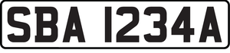



System Architecture Diagram
Detect Plate number
Computer
Take picture/Upload images of car plate
Mobile Devices
Notes:
natasha
When we first created the website, we hosted it on PythonAnywhere which offers Flask framework and a MYSQL database. PythonAnywhere also allows us to code remotely which enables us to execute various SQL commands such as SQLAlchemy for our program. By using the Flask framework, we are able to implement the API which is known as Plate Recogniser which allows computer and mobile devices to take or upload pictures of the vehicle and detect the carplate number via the web server.

Slide 7
Key Requirements of the Project
To develop a mobile friendly web application using Flask Python to identify the license plate number of a vehicle using a mobile phone, that will match against the list of approved vehicles.
Key functionalities:
  Vehicle management module to add, edit, delete and perform mass-upload of vehicles and owner information
  AI Image recognition for license plate number
  Vehicle matching system to identify owner and status of vehicle clearance
Notes:
izharfan
The key requirements of our project is to develop a mobile friendly web application using Flask Python to identify
the license plate number of a vehicle using a mobile phone. This will then be matched againts the list of approved
vehicles in the database.
The key funcitonalities would be a CRUD of vehicles, AI image recognition for license plate and vehicle matching
system to identify owner and status of vehicle

Slide 8
Project Scope Expansion
We have also added on different functions to expand our scope such as:
User Management - contains main menu, user profile, create, delete and update user.
Report
  Contains 11 reports
  Contains a dashboard and 11 charts based on the reports
  Admin can filter the charts that they want to view in the dashboard
  Admin can click on the legends to view or hide in the chart
Calendar Function (Event Management) - admin can add events such as RP lockdowns and events, which will be highlighted in their respective colors.
Notes:
izharfan
To ensure that all of our members have an equal amount of tasks, we decided to expand our scope. Some tasks which we have added would be,

Slide 9
Project Scope Expansion
4. User Audit - Admins are able to view an audit of all user actions in the
web app
5. Post - contains Feedback and Bug posts.
  Users are able to create posts to give feedbacks or to report a bug in the web application.
  Users are able to comment and leave a like on the posts.
  Admins are able to update the status of the bug posts.
Notes:
izharfan

Slide 10
Project Scope Expansion
6. Track Illegal Parking Function :
  30 Minutes Grace Parking - Users can check against the list for the duration of the vehicle parked illegally. Vehicle will automatically be listed in the warning list when found to be parked at the illegal location for more than 30 minutes.
  Warning State - A list of vehicles that have received warnings. Vehicles that have parked illegally will be recorded and indicated with a warning status.
  Blacklist State – Vehicles will automatically be blacklisted after 5 warnings are recorded and the status will be changed to “Blacklisted”
7. Appeal Function:
  Public users are able to submit appeals if their car has been blacklisted
  Admins are able to Approve or Reject appeals
  An email will be triggered to the car owner when the appeal has been approved or rejected
Notes:
izharfan
User scan illegally parked vehicle and log entry created
Within 30 mins, user return and scan illegally parked vehicle. System will show parking duration
After 30 mins, user return and scan illegally parked vehicle, system shows exceeding allowed duration > Vehicle recorded as warning received
After 5 warning records of vehicle. vehicle marked as blacklist.

Slide 11
Car Plate Recognition Comparison
OpenALPR
  In order to use this car plate recogniser API, we have to choose a plan and pay to use it. The cheapest plan is $29 for 2500 maximum calls per month.
OpenCSV (Non API)
  We have tried to implement a car plate recogniser without using an API and installed python libraries such as “OpenCSV” to start implementing the codes.
  Requires a large amount of storage and takes up most of the storage space in PythonAnywhere
  Very inconvenient to implement due to many steps, codes and time constraints.
Notes:
daniel
OpenCSV : Due to the time constraint we would not prefer to choose to do it manually without the API because there is too many files and codes to implement, we choose to use API to read the car plate number instead.

Slide 12
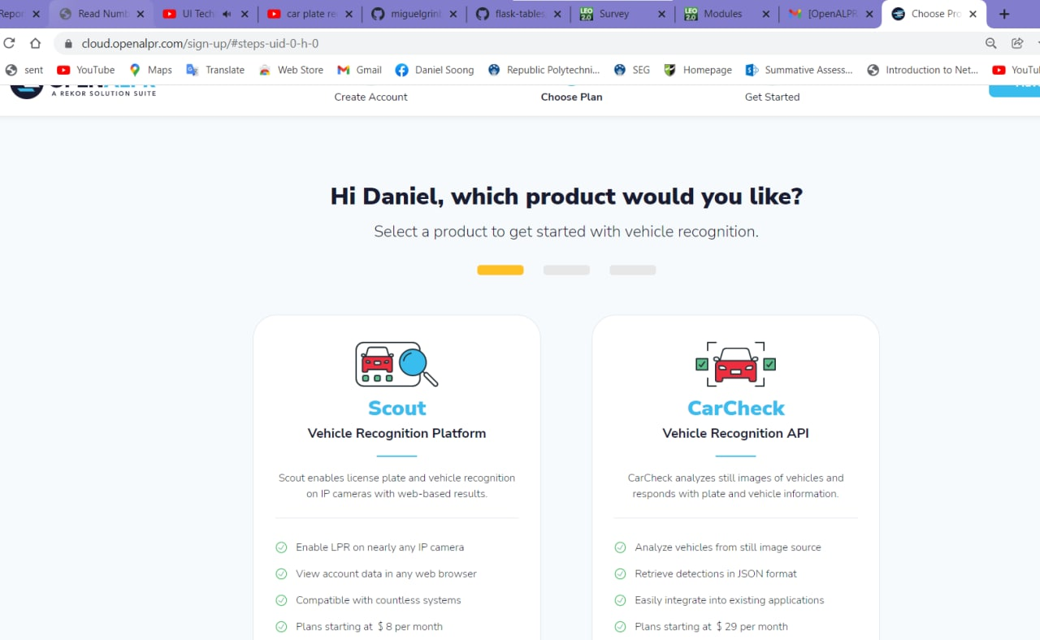
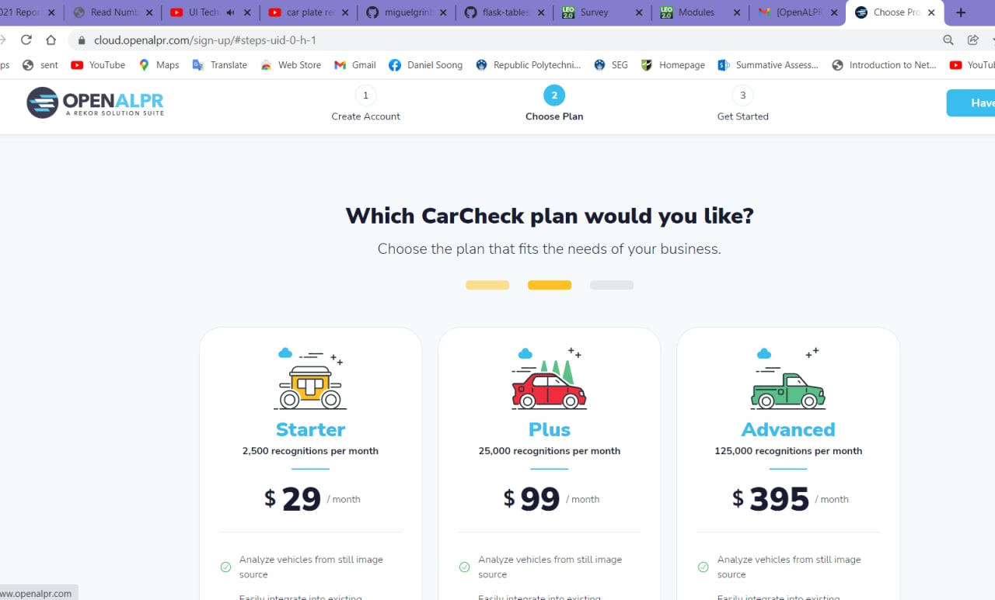
OpenALPR
Notes:
daniel

Slide 13
Chosen API
Plate Recogniser API
  Free with 2500 maximum calls per month
  Easy to implement with minimal codes needed
  Provided clear documentation on the process of implementing the API
  Supports many car plate types depending on the country
Notes:
daniel

Slide 14
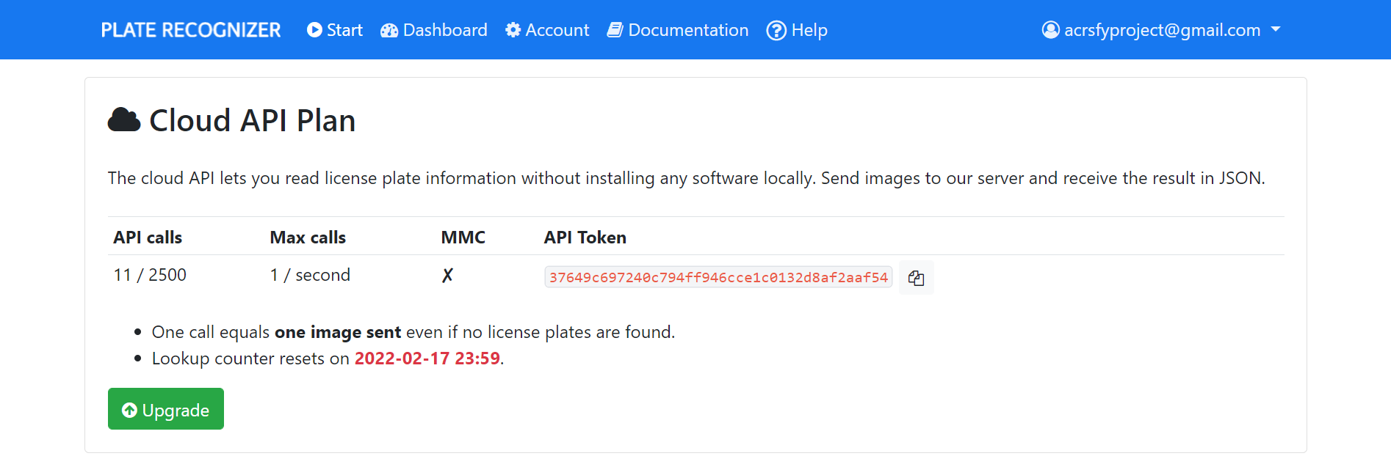
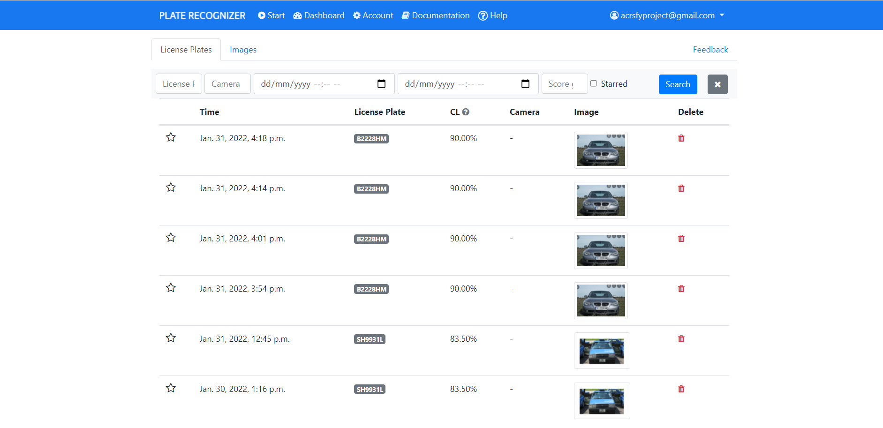
Plate Recogniser API
Notes:
daniel

Slide 15
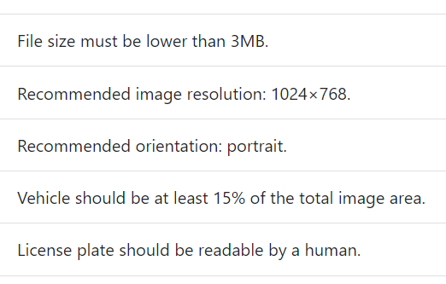
Process of reading the Plate Number
In order for the API to read the car plate number the image has to be:
Notes:
daniel

Slide 16
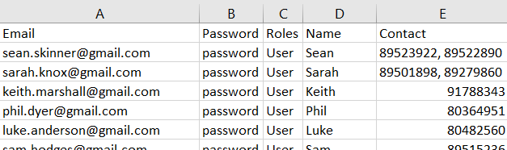
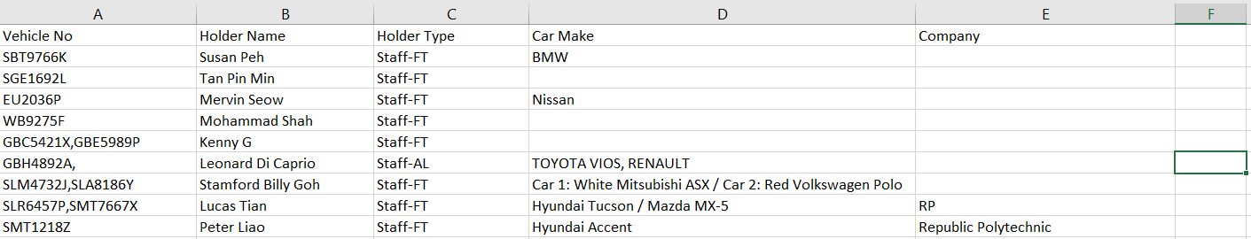
Process of Performing Mass Upload CSV
Format for Mass Upload of User:
Format for Mass Upload of Vehicle:
Notes:
daniel
For the Mass Uploading for CSV, the data will have to be uploaded in a specific format. For example the User’s data has to be in Email, Password, Roles, Name and Contact, in that order.
and for vehicle the format should be in Vehicle No, Holdername, holder type, car make and company in order.

Slide 17
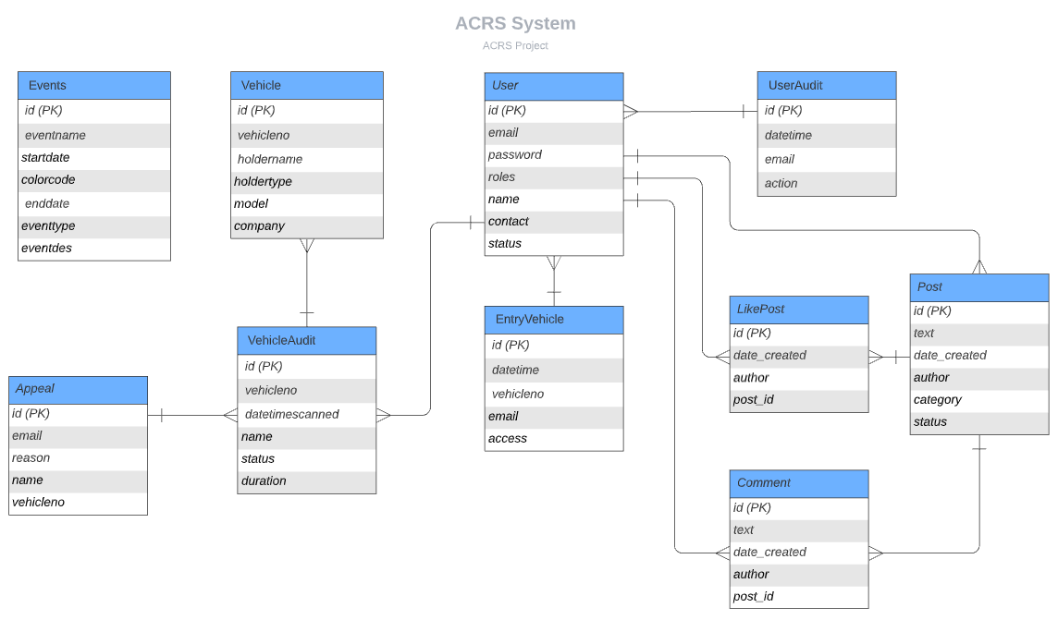
ERD
Notes:
elly
This is our ERD sys entity relationship diagram

Slide 18
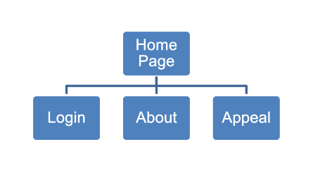
Page Flow (Public User)
Notes:
elly

Slide 19
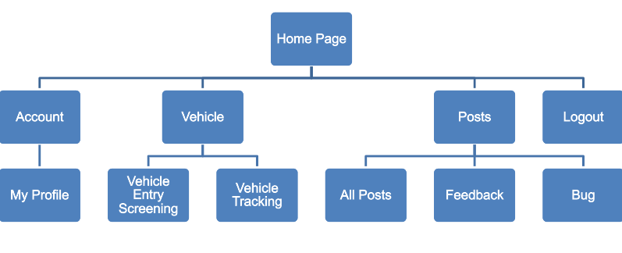
Page Flow (User)
Notes:
elly

Slide 20
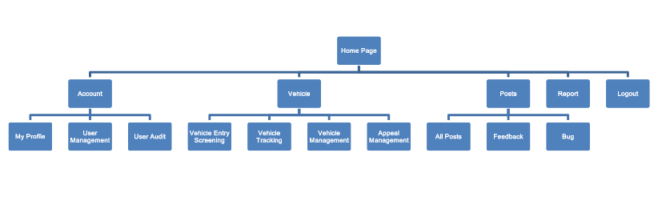
Page Flow (Admin)
Notes:
elly

Slide 21
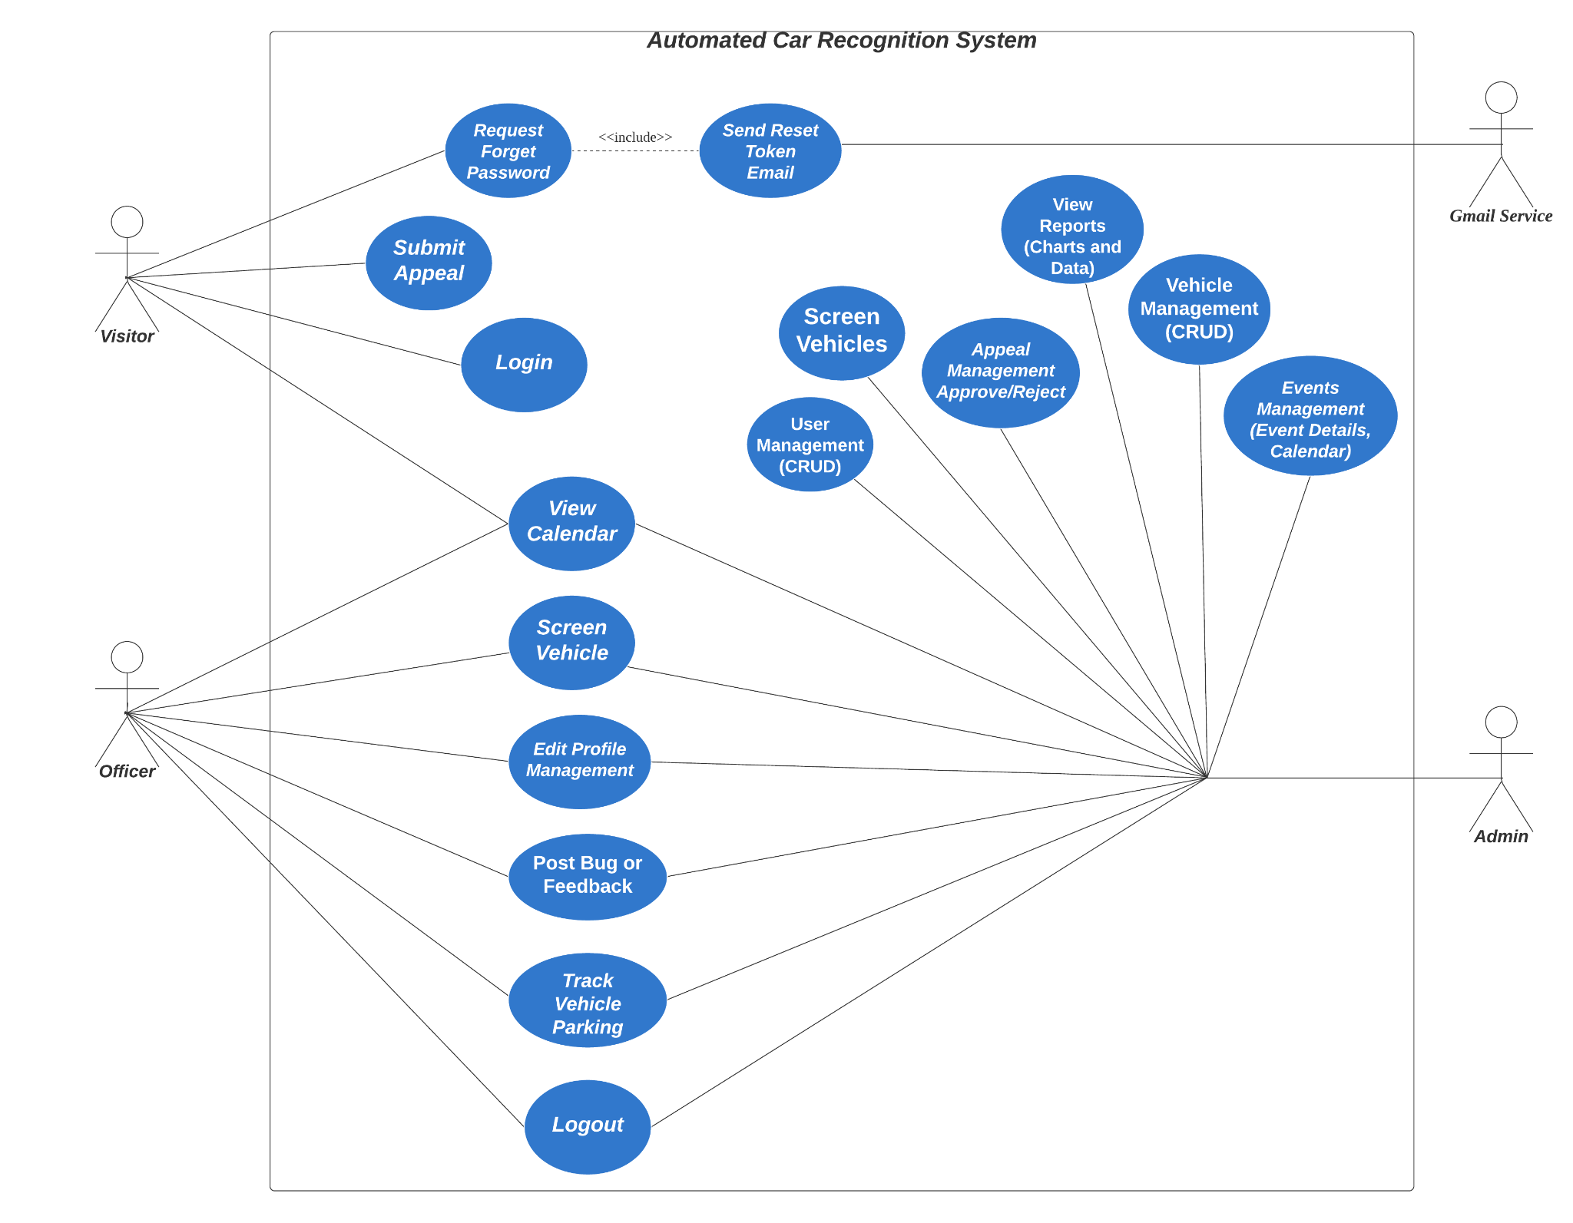
Use Case Diagram
Notes:
elly
this is our use case showing all the different roles and how they can access the system

Slide 22
Task Allocation and Progress
Soong Jia Kang Daniel
Task | Progress
Vehicle Management: Implement an Vehicle Mass Upload from CSV | 100%
Event Management (Calendar Function) Implement the Calendar in the Home page for users to click on the highlighted coloured events to view for more information about the events. Red = Lockdown, Blue = Events. Implement Create, Multiple Delete and Update for Event Management Implement Entry Vehicle list where Security Guard and Admin are able to see which vehicle have entered the school on the highlighted event dates. Implement event and entry vehicle list for a detailed list of the data using AJAX Table (Filter, Search and Pagination) | 100%
User Audit: Implement the tracking of the time and action where any user make any changes of data to : Events Management User Management Vehicle Management | 100%
Entry Vehicle Screening: Implement Manual Search for Car plate screening Implement the file size check and compress of the image before uploading Implement the API “Plate Recognizer” to detect for car plate number when taking picture of a vehicle Implement entry vehicle today or by date for a detailed list of the data using AJAX Table (Filter, Search and Pagination) | 100%
Notes:
daniel
We will be going through our Task allocation and progress. We will go into detail on the challenges that we faced later in the demo.

Slide 23
Task Allocation and Progress
Nurul Natasha Bte Rizal
Task | Progress
User Management: Implement an User Mass Upload from CSV | 100%
Report: Implement a data table based on the report Implement a View List for a detailed list of the report using AJAX Table (Filter, Search and Pagination) Implement 11 reports Implement charts based on the reports Implement clickable legend where user can click on the legend to choose the data they want to view in the chart Implement Dashboard Implement a Sidebar for the list of report Implement Checkbox for user to filter the charts they want to view on the dashboard | 100%
30 Minutes Grace Parking Function: Implement the list of 30 Minutes Grace Parking Implement AJAX Table for the list (Filter, Search and Pagination) Implement the manual insert function Implement the calculation of duration between the initial datetime and recent datetime If duration is more than 30 Minutes, the carplate number will automatically be transferred to the Warning List Implement delete function | 100%
Notes:
natasha

Slide 24
Task Allocation and Progress
Muhamad Izharfan Bin Zuraimi
Task | Progress
Account: My Profile Update user details (Email, Contact, Name) Change Password User Management (Admin) Create, Multiple Delete, Update User Implement usage of Ajax data table (Searching, Pagination, Filter) | 100%
Posts Management: View All Posts (Bug, Feedback, Post of a User) Delete Post (Only creator of the post) Like Post Comment (View comments, Delete comment) Update Status of Bug Post (Admin) | 100%
Forget Password: Request Password Reset: Send Email to User with reset password Token link | 100%
Notes:
izharfan
For my task allocation, I manage to complete all the task given to me. For account, I have successfully implemented
my profile where users can change their email, contact number, name and password
User management is for the Admins to create update and delete users which i implemented by using ajax table.
I also created a post system where users are able to post a feedback or bugs about the application where other
users can like and comment on them. Admins can also update the status of the bug posts.
Lastly, i implemented the forget password function for users who forget their password. Users will receive a
token where a link to reset their password will be emailed to them.

Slide 25
Task Allocation and Progress
Elly Haniz Bte Mohamed Ghazali
Task | Progress
Vehicle Management (Admin) Create, Multiple Delete, Update Vehicle Implement usage of Ajax data table (Searching, Pagination, Filter) | 100%
Appeal: Appeal Management (Admin): View All Appeals Reject Appeals Approve Appeal Email will be triggered when action is taken on appeals Implement usage of Ajax data table (Searching, Pagination, Filter) Submit Appeal (Public) | 100%
Warning Function: View all vehicles with Warning Status If number of warnings exceed 5, status will be updated to “Blacklisted” Implement usage of Ajax data table (Searching, Pagination, Filter) Blacklist: View all vehicles with “Blacklisted” status Implement usage of Ajax data table (Searching, Pagination, Filter) | 100%
Notes:
elly

Slide 26
Records of Team Meetings with Supervisor
Name | 20th Oct | 27th Oct | 3rd Nov | 17th Nov | 24th Nov | 1st Dec | 10th Dec | 24th Dec | 5th Jan | 26th Jan | 7th Feb
Daniel | Present | Present | Present | Present | Present | Present | Present | Present | Present | Present | Present
Natasha | Present | Present | Present | Present | Present | Present | Present | Present | Present | Present | Present
Izharfan | Present | Present | Present | Present | Present | Present | Present | Present | Present | Present | Present
Elly | Present | Present | Present | Present | Present | Present | Absent (LOA) | Present | Present | Present | Present

Slide 27
Prototype Walkthrough

Slide 28

Car Plate Scanning Demo

